Slide 1

Deep Learning for Type B Aortic Dissection
Ayman Abaid
Supervisor: Dr. Ihsan Ullah
School of Computer Science, University of Galway
Notes:
My name is Ayman Abaid, and I am currently a second-year PhD student at the School of Computer Science, University of Galway, under the supervision of Dr. Ihsan Ullah.
Today, I’ll be presenting one of the projects I have been working on, which focuses on the use of DL in diagnosing Type B Aortic Dissection (TBAD).
I’ll take briefly about the motivation behind this work, and the specific challenges we aimed to address.
Thank you for the introduction.

Slide 2
Co-Authors
Ihsan Ullah
Head of Visual Intelligence Lab
School of Computer Science, University of Galway
Data Science Institute, Insight SFI Research Centre for Data Analytics
Ali Farooq​
School of Engineering, College of Science and Engineering, University of Galway​
Peter Corcoran​
School of Engineering, College of Science and Engineering, University of Galway
Talha Iqbal​​
Insight SFI Research Centre for Data Analytics​
Post-Doc Researcher at Visual Intelligence Lab
Srinivas Ilancheran​​
School of Computer Science, University of Galway
Student Research Intern at Visual Intelligence Lab
Niamh Hynes​
School of Medicine, University of Galway
GalwayClinic
Notes:
Firstly, all the work I will be presenting today is the result of a collaborative effort with my amazing co-authors from the Visual Intelligence Lab, colleagues from the School of Engineering, and, for clinical validation, we partnered with cardiovascular surgeon Dr. Niamh Hynes.

Slide 3
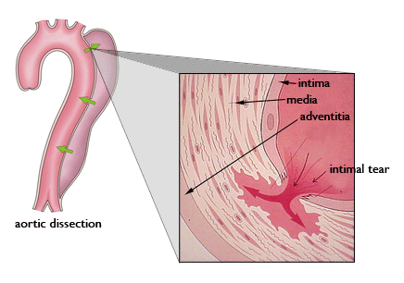
Aortic Dissection(AD)
It occurs when a tear occurs in the inner layer of aorta, causing the inner and middle layers of the aorta to separate
Classification System
Stanford: Type A, Type B
2
2
Image credits: https://www.intechopen.com/chapters/44000
Notes:
As you may already know, aorta is the largest artery of the heart and aortic dissection occurs when there is a tear in the inner layer of aorta, which cause the inner and middle layer to seperate. This seperation creates a new channel for the blood to flow called 'False lumen'.in addition to the existing 'true channel' or called 'True Lumen'. This alters the blood flow pattern, potentially affecting blood supply to vital organs, including the heart itself.
​Aortic dissection is typically classified based on either the location of the tear in the aortic wall and the extent of the dissection. The two priomary classification systmen used are stanford and Debakey classification.
As FLT can appear almost anywhere along the aorta with irregular shapes, segmentation of FLT presents a wide class of segmentation problems where targets exist in a variety of positions with irregular shapes. ​
​

Slide 4
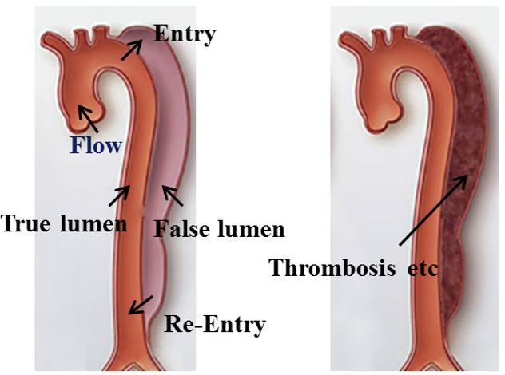
Type-B Aortic Dissection (TBAD)
Dissection taking place in the descending aorta.
Appearance of FLT
Imaging: CTA
Diagnostic process of TBAD involves segmentation of FL, TL, FLT.
Manual segmentation is laborious and time taking.
3
3
Image Credits: https://www.intechopen.com/chapters/44000
Notes:
Type B aortic dissection (TBAD) occurs when the dissection takes place in the descending part of the aorta. In some rare cases, a blood clot forms in the false lumen, referred to as a false lumen thrombus.
Several imaging modalities can be used to diagnose TBAD, However, for this study, we chose to use CTA.
For TBAD, the most critical feature to monitor over time is the maximum aortic diameter of the dissected aorta. Measuring this is challenging, especially over multiple follow-up studies. Currently, medical practitioners manually label regions corresponding to the false lumen, true lumen, and false lumen thrombus—a process that is both labor-intensive and time-consuming.

Slide 5
Motivation
AD affects 2 to 6 out of every 100,000 people each year.
If left untreated, 80% die within 2 weeks; 90% within a year.
All type B dissections need quick treatment.
TBAD misdiagnosis: 14% to 39%, concerning for a time dependent disease.
4
Notes:
So ehy do we care about this particular
Aortic dissection extremely serious medical condition, affects 2 to 6 out of every 100,000 people each year.
Without treatment, almost 80% of patients die within 2 weeks. The mortality rate increases to 90% within the first year.
All type B dissections require prompt medical treatment to prevent aortic rupture.
Liteature reports Misdiagnosis rate of 14% to 39% for TBAD patients, raising concerns, especially for such a time-dependent disease.
1-https://link.springer.com/article/10.1007/s00330-021-07849-2​
2-A. Karthikesalingam, The diagnosis and management of aortic dissection, Vascular and Endovascular Surgery 44 (2010) 165–169.​
4- M. S. Hansen, G. J. Nogareda, S. J. Hutchison, Frequency of and inappropriate treatment of misdiagnosis of acute aortic dissection, The American journal of cardiology 99 (6) (2007) 852–856.​
​
https://www.ncbi.nlm.nih.gov/pmc/articles/PMC5945851/​
​
​
The literature also reports the misdiagnosis rate of 14% to 39% for TBAD patients, raising concerns, especially for such a time-dependent disease [7, 8, 9].​
​
Patients with aortic dissection require lifelong surveillance with imaging.8 The most important feature to track over time is the maximum aortic diameter of the dissected aorta, which is difficult to measure, particularly over the course of several follow up studies.8 Accurate and robust segmentation of aortic dissection may allow automatic assessment of morphologic imaging features during aortic surveillance.8 Due to the time and expertise required, manual segmentation of the dissected aorta is not routinely performed in clinical settings

Slide 6
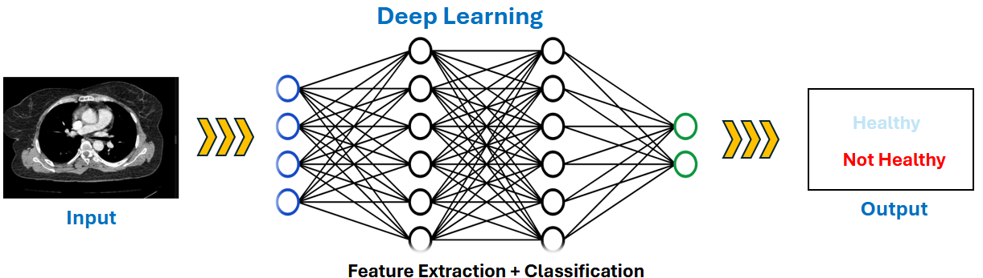
Deep Learning
Deep learning is a subset of AI that uses neural networks with multiple layers (hence "deep") to automatically extract and learn complex patterns from large datasets.
5
Notes:
I probablity don’t need to talk about the promise of AI but Ill brielfy explain what ddep learning is . Deep learning is a subset of machine learning that uses neural networks with multiple layers (hence "deep") to automatically learn and extract complex patterns from large datasets.

Slide 7
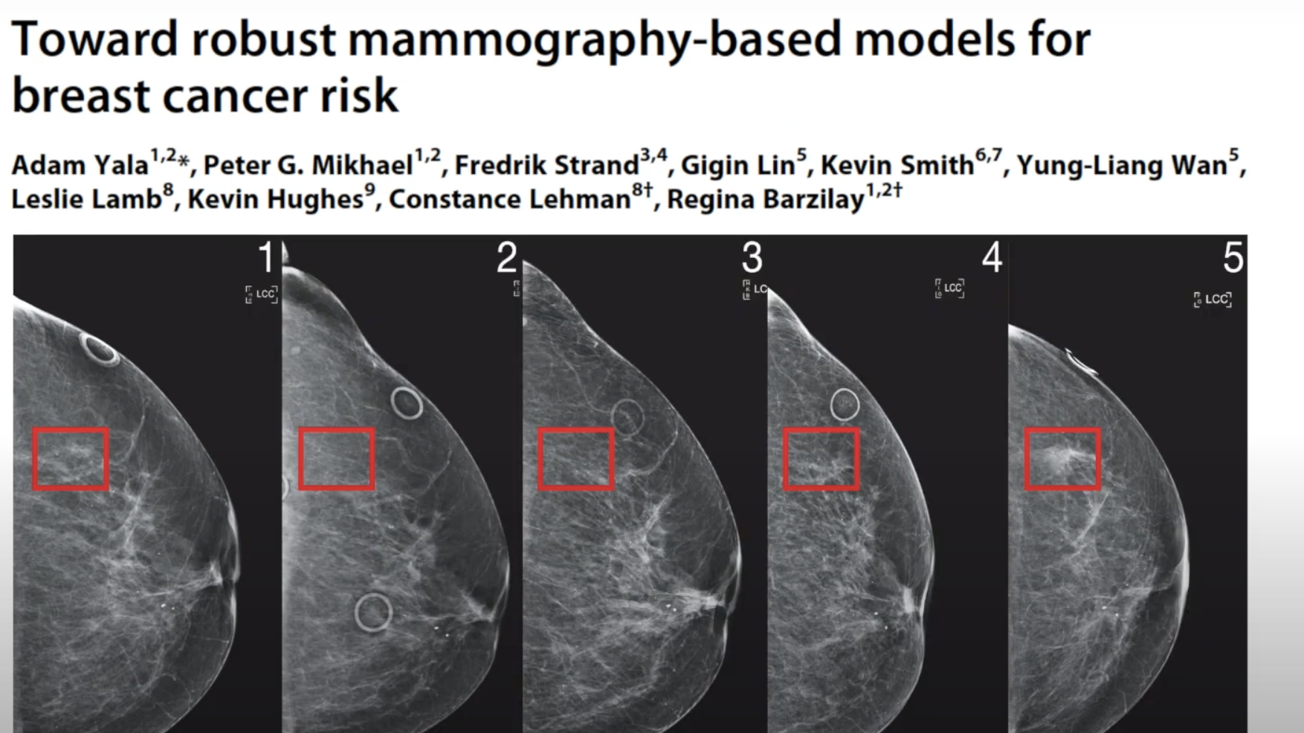
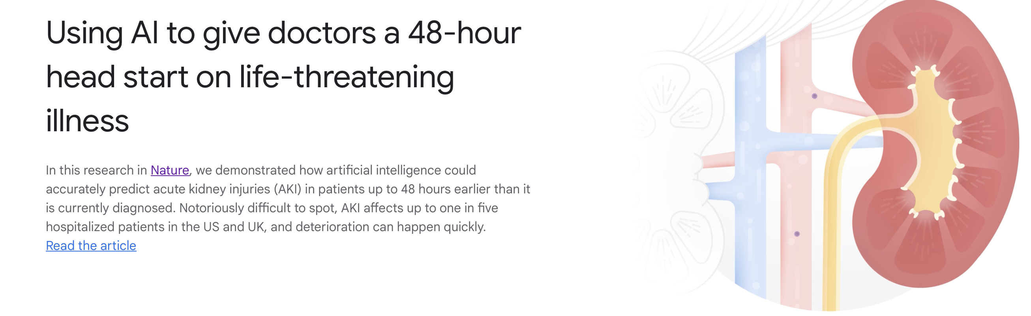
Deep Learning in Healthcare
With enough data, deep learning can match or even exceed human-level accuracy in specific tasks.
6
Notes:
You might have seen in news or social media about the developing new AI systems that could be used to help diagnose breast and lung cancer before the cancers are detectable to the human eye. Also
By integrating deep learning, with healthacre we can improve diagnostics, optimize workflows, and provide more personalized care.

Slide 8
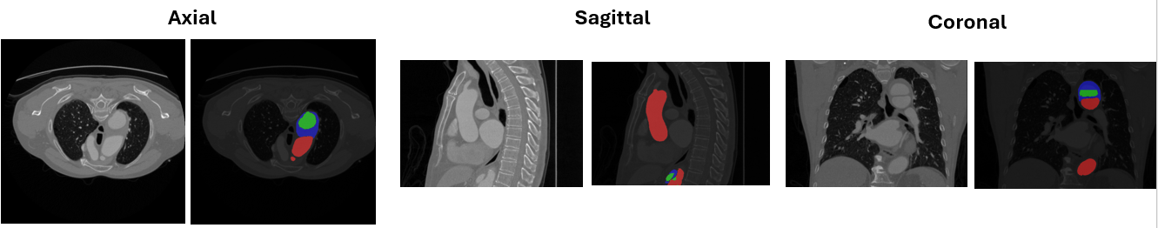
Dataset
100 TBAD 3D CTA volumes proposed by Yao et al. [3].
Manual pixel-level annotation for GT labels of TL, FL and FLT was done by a team of two cardiologist.
3D Volumes are converted into 2D images by considering each slice as an individual image.
7
Notes:
Okay, moving back to our original problem. The datatste we have used in this study was collected by Yao et al form a hospital in chain

Slide 9
Existing Work
Following studies use 3d CTA for TBAD prognosis
Work | Models | Dice Score
 |  | TL | FL | FLT
* ImageTBAD: A 3D Computed Tomography Angiography Image Dataset for Automatic Segmentation of Type-B Aortic Dissection [1] |  | 0.79 | 0.68 | 0.50
Fully automatic segmentation of type B aortic dissection from CTA images enabled by deep learning [6] |  | 0.93 | 0.91 | -
Deep Learning-Based 3D Segmentation of True Lumen, False Lumen, and False Lumen Thrombosis in Type-B Aortic Dissection[7] | Model 1 | 0.74 | 0.83 | 0.63
 | Model 2 | 0.86 | 0.86 | 0.50
 | Model 3 | - | - | 0.85
8
Notes:
Firstly, there is not a lot of work done in diagnosis of type b aortic dissection using DL CTA first TBAD 1) is a rare disease and 2) there is no public dataset available and the studies that I have listed are te ones that are most relevant to the objective of my research This is where we stand in terms of accuracy of diagnosis using deep learning.
Current research in the field has laid the groundwork, but there's still much to explore to comprehend the intricate dynamics at play.

Slide 10
Limitations
Limited prevalence of TBAD makes it difficult to acquire the large datasets necessary for deep learning (DL) training.
Annotating medical imaging data (e.g., CT or MRI scans) requires expert clinicians, which is time-consuming and expensive.
Training 3D Neural Networks requires high processing power and large memory capacity.
9
Notes:
TBAD is a Rare Disease: it difficult to acquire large datasets necessary for deep learning (DL) training.
Secondly even if we have data from patient and DL models to work it has to be annotated , which require expert clincians anf they do the annotationw hich us again time consuing nand expensive.

Slide 11
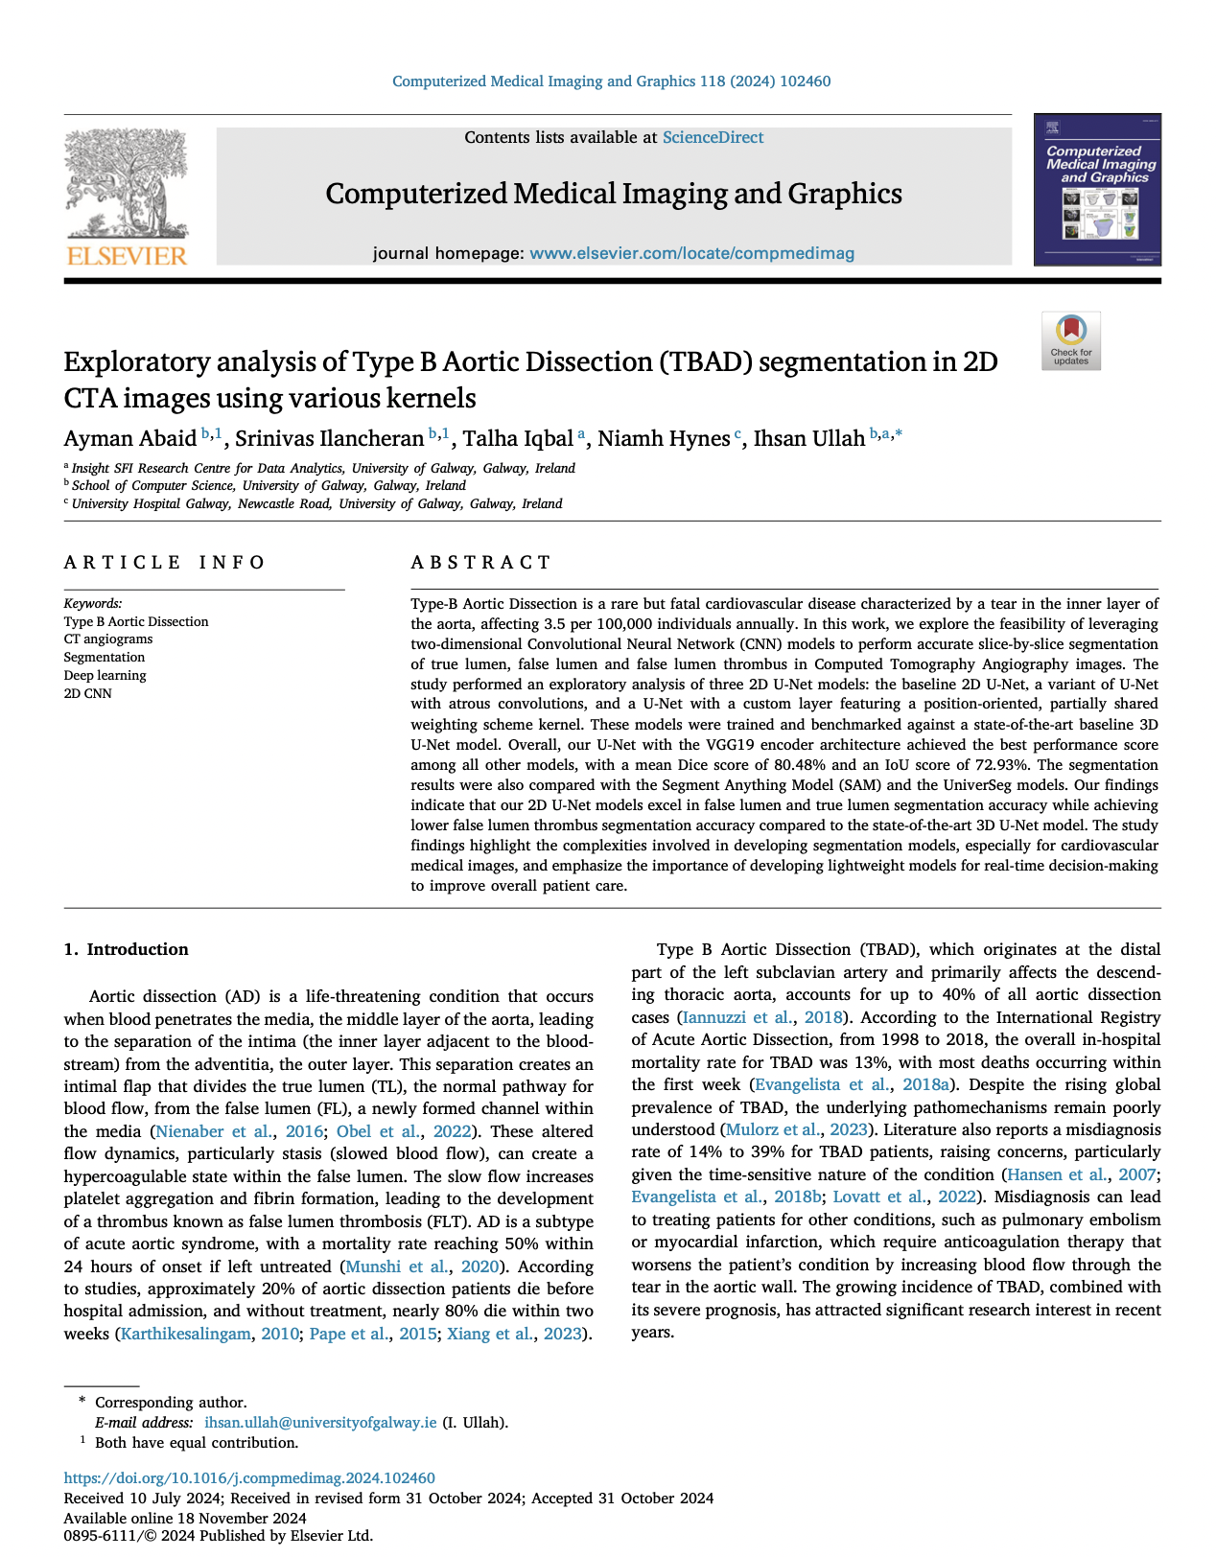
Can 2D Image Segmentation Perform As Good As 3D Volumetric Segmentation In Type B Aortic Dissection?
10
Notes:
So we began our project by investigating

Slide 12
Can 2D Image Segmentation Perform As Good As 3D Volumetric Segmentation In Type B Aortic Dissection?
Method | TL | FL | FLT
3D Unet ImageTBAD [1] | 79.0% | 68.0% | 50.0 %
2D Unet (ours) | 83.14% | 84.90% | 30.41%
2D Unet with Atorus Convolution (ours) | 75.72% | 80.06% | 23.47%
2D Unet with Custom Layer (ours) | 78.51% | 81.89% | 6.72%
Table 1: Mean Dice Score (DSC) achieved by Proposed Models on Testing Dataset
11
Notes:
For this we used a 2d unet (and usnet is a neurlanetwork that is used for sgementation)

Slide 13
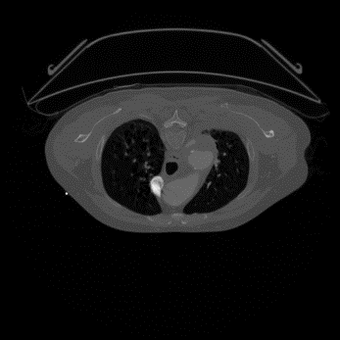
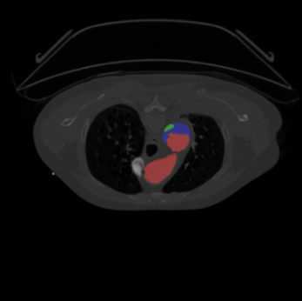
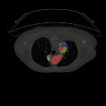

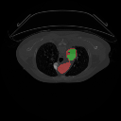
Segmentation Results
Input Image
Ground Truth Mask
Baseline UNet
Atrous Convolution
Custom Layer
12
Fig.3: Input images, annotated masks and segmentation results of proposed models and UniverSeg. Green is TL, Red is FL, and Blue is FLT region.
Notes:
This is a somewhat complicated case. Firstly, all three regions are present, and the region belonging to the FL is significantly larger compared to the other two. As a result, the model is able to detect that all three lumens are present and identify the boundary of the aorta. However, it still mislabels slightly in some areas.

Slide 14
Limitations
3D U-Net model outperformed our proposed models in segmenting the FLT segment.
Small sample size i.e. data from only 100 patients with 68 patients have FLT.
Existing studies including ours suggest there's still ample opportunity for enhancement, particularly in achieving higher segmentation accuracy for FLT.
13
Notes:
So in this study we compared the performance of our proposed 2D U-Net models with the state-of-the-art 3D U-Net model, and baseline 2d Unet gave better results as compared to the 3d unet for TL and FL. While The 3D U-Net model outperformed our models in segmenting the FLT area. This could be due to small data since FLT is a minority class and images were fewer in numbers.
Both our study and existing study suggests that there is still a large room for improvements , particularly when it comes to segmentation of FLT

Slide 15
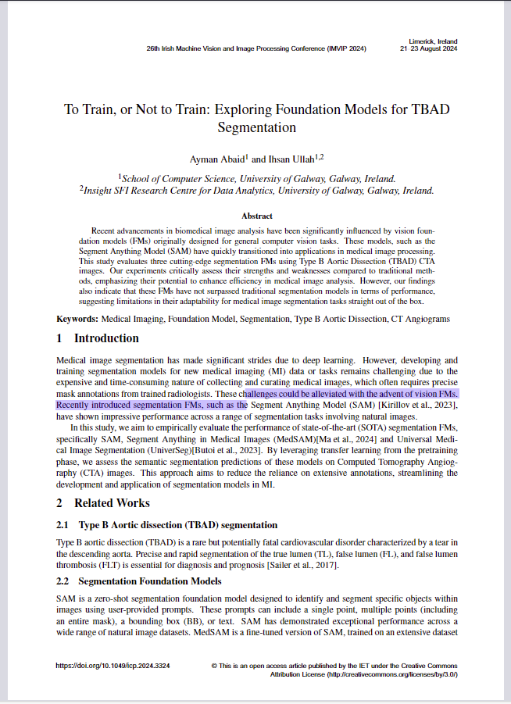
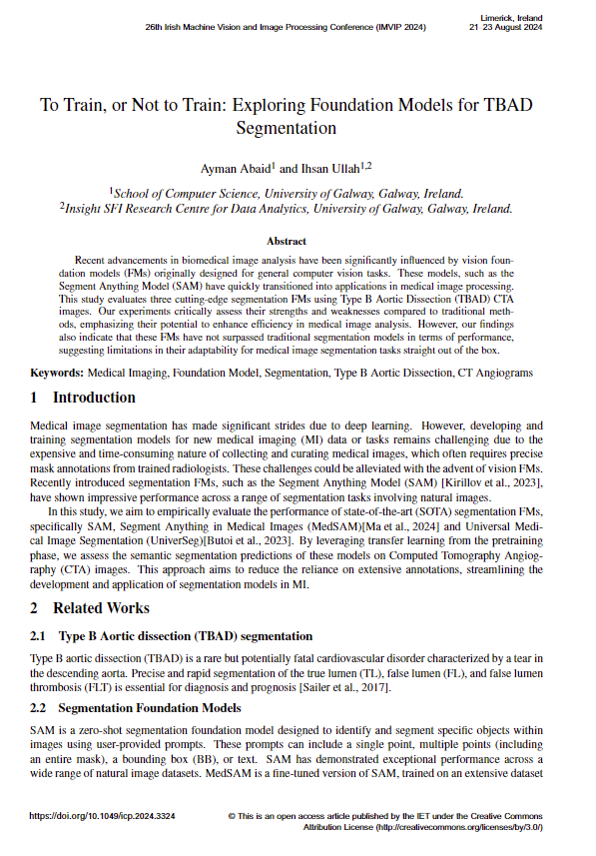
RQ.2.a: Can we use pretrained foundation models for TBAD segmentation without needing to train them?
14
Notes:
While exploring the limitations of 2D image segmentation compared to 3D volumetric segmentation it became evident that addressing these challenges might require leveraging advanced approaches,
leading to my second research question: Can we utilize pretrained foundation models for TBAD segmentation without the need for extensive retraining?"

Slide 16

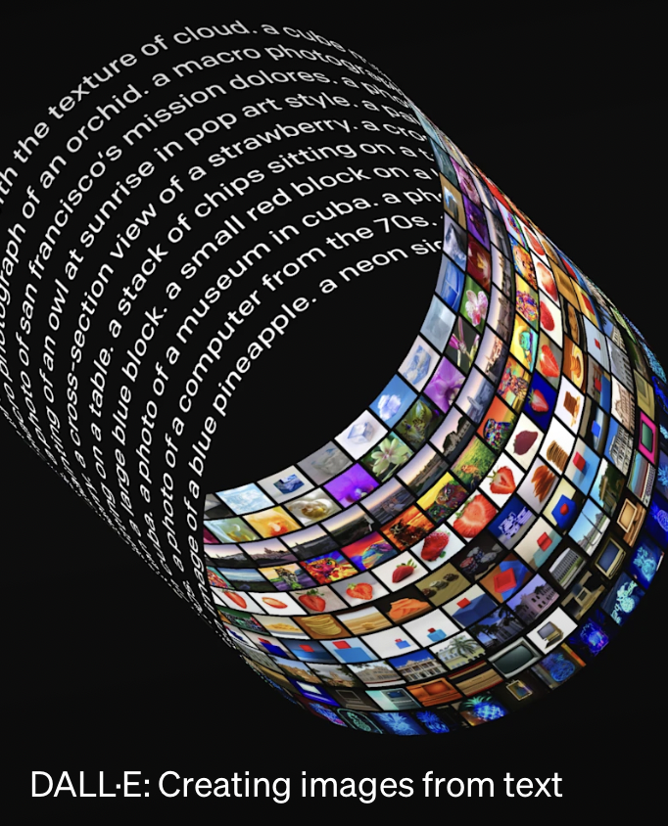
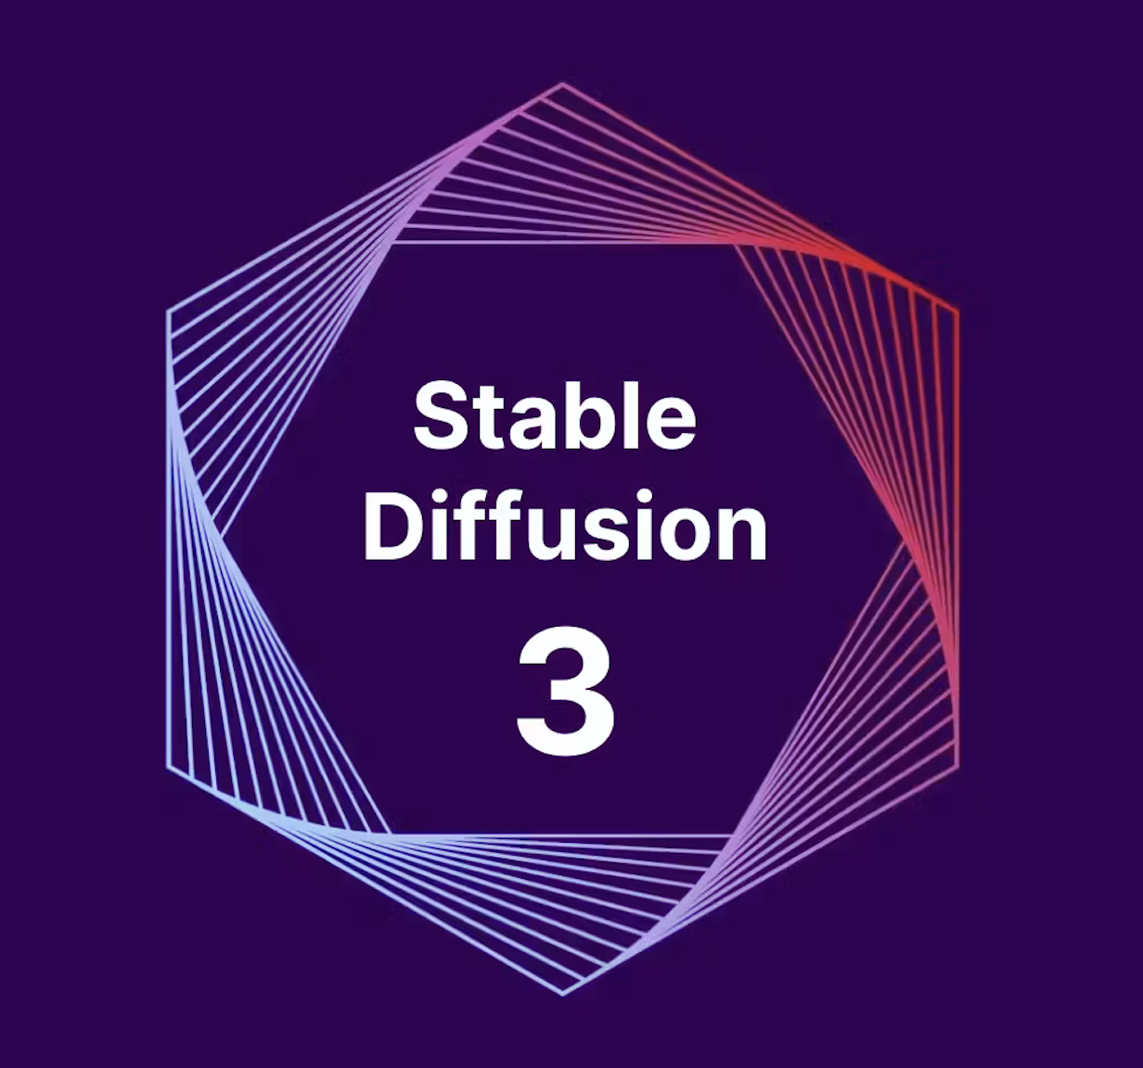
Generative Foundation Models
Text
Images, Videos
15
Notes:
You prpbably have used Chatgpt which is alsoa. foundation model, however it’s a generative foundation model

Slide 17
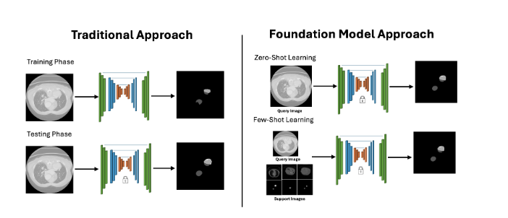
Segmentation Foundation Models (FM)
16
Notes:
Foundation models are trained on extensive and diverse datasets to learn general patterns and representations.
exploration of whether it's necessary to train new models from scratch or leverage existing foundation models for the task of segmenting Type B Aortic Dissection (TBAD) . Training a new model from scratch: Time- and resource-intensive but potentially more accurate for a specific task.
Using or fine-tuning foundation models: Faster and resource-efficient but might require adaptation to achieve optimal performance for TBAD.

Slide 18
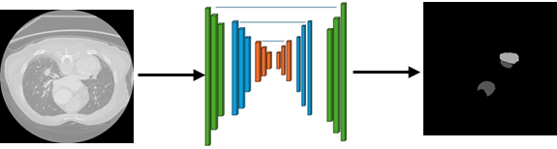
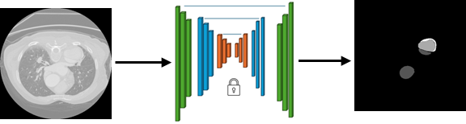
Traditional Deep Learning
Training Phase
Testing Phase
17

Slide 19
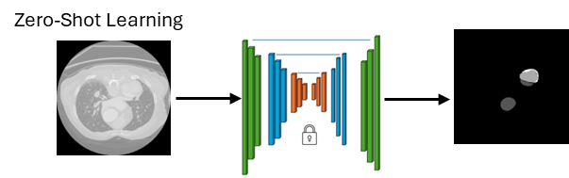
Segmentation Foundation Models
18

Slide 20
Segmentation FMs for TBADS
Segment Anything Model (SAM) by Meta AI
Trained on 11 million images, primarily natural images, with some medical modalities included.
Segment Anything in Medical Images (MedSAM)
A fine-tuned version of SAM trained specifically on medical datasets.
Universal Medical Image Segmentation (UniverSeg)
Trained on 53 datasets covering 26 medical domains and 16 imaging modalities.
19

Slide 21
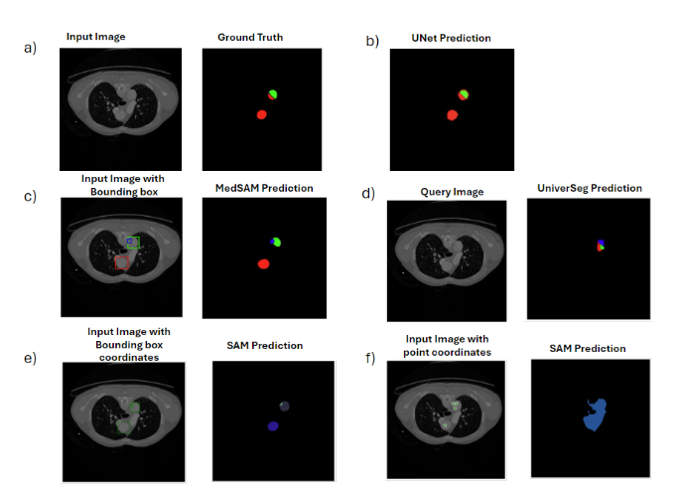
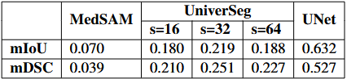
Segmentation Results
Table 2: Performance comparison of UniverSeg, MedSAM, and UNet on CTA image segmentation
Figure 5: Comparison of input images, ground truth, and predictions by UNet and three FMs. (a) Input image and GT. (b) Prediction by UNet. (c) Prediction by MedSAM (d) Prediction by UniverSeg (e-f). In the predicted masks and GT, blue regions represent FLT, red regions denote FL, and green regions correspond to TL
20

Slide 22
Limitations
SAM and MedSAM are limited to single-ROI detection and lack multi-label segmentation, reducing their utility in complex medical imaging (MI) scenarios.
They require prompts, such as bounding boxes (BB) and point coordinates.
All evaluated foundation models (FMs) rely on 2D segmentation, despite the prevalence of 3D MI data in clinical practice.
21
Notes:
Several limitations of FM are highlighted in our study. SAM and MedSAM, for instance, are restricted
to detecting only a single ROI per prompt, limiting their utility in complex MI scenarios. Furthermore, these
models do not support multi-label segmentation, which is crucial for many MI tasks. They also necessitate
prompts such as BB and point coordinates, requiring prior anatomical knowledge and professional expertise,
making them less accessible for general use. Another significant limitation is that all evaluated FMs rely on
2D segmentation, despite the prevalence of 3D MI data in clinical practice, emphasizing the need for advanced
models capable of handling 3D data

Slide 23
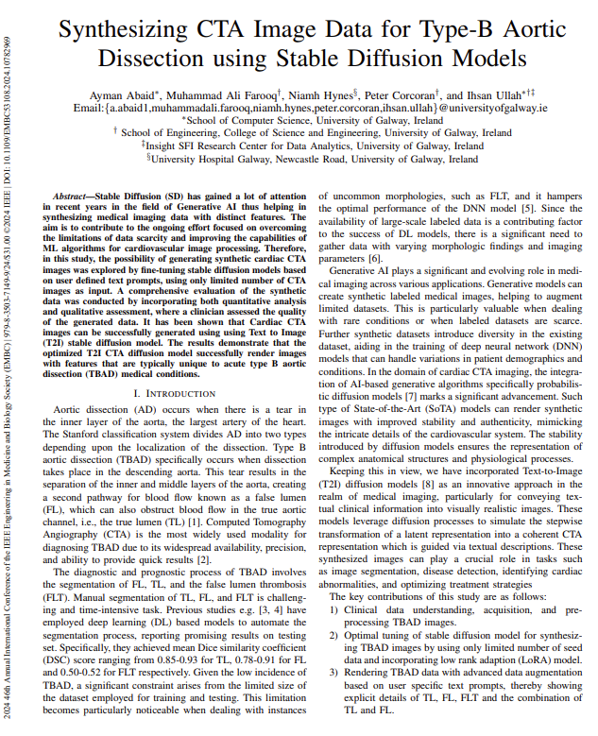
RQ.2.b: Can synthetic 2D data significantly improve how well the segmentation algorithm identifies TBAD?
22
Notes:
So we stepped back a little and focuses on other apporached to improve deep leanring models
N performance . Since deep learning models woek really we have large amount of data , we vertigated can we generate synthetic medical images

Slide 24
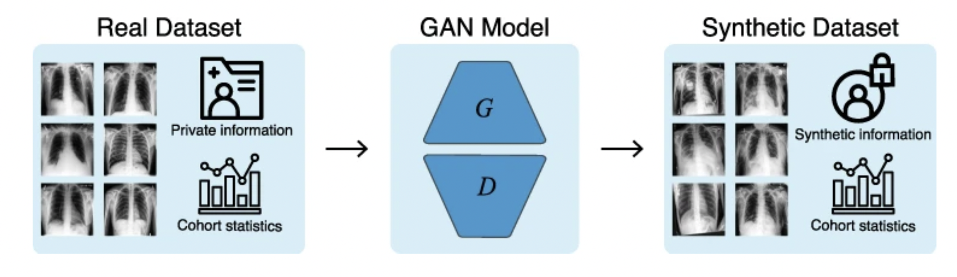
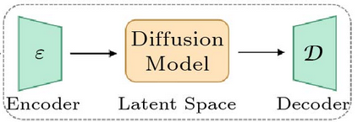
Synthetic Data
Diffusion Model​
Ref: https://www.nature.com/articles/s41746-021-00507-3
23
Notes:
Synthetic medical images are artificially generated images that mimic real medical images, created using computational methods rather than direct acquisition from medical imaging devices like CT, MRI, or X-ray scanners. We have diffusion models instead of high quality diagnostically
accurate synthetic computed tomography angiography (CTA)

Slide 25
Synthetic CTA Image Generation
Fine tuning of Text to Image diffusion model for synthesis of CTA Images by incorporating few-shot image learning and low rank adaption (LoRA).
Validating rendered CTA using qualitative and quantitative methods.
24
Notes:
The objectives of this study are as follows:
So in an effort to generate synthetic images, we fine-tuned Text to image diffsuion model i.e. Imagen by incorporating dreambooth and LoRA. We rendering TBAD data with advanced data augmentation based on user specific text prompts.
Validating rendered CTA using qualitative and quantitative methods.

Slide 26
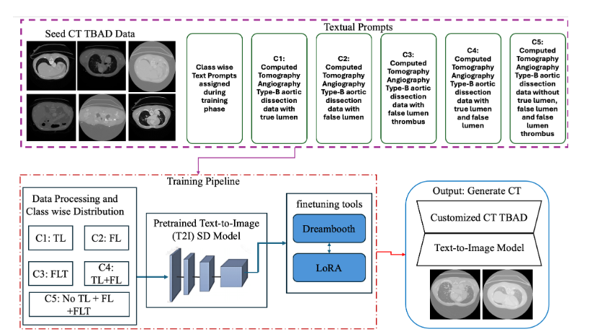
Methodology for CTA Generation
25
Notes:
We began by divind data into 5 classes such that we all that image that contained only tl were considered class1 we have incorporated Text-to-Image (T2I) diffusion models
Optimal tuning of stable diffusion model for high quality image synthesis of Type-B Aortic Dissection images by incorporating few-shot image learning and low rank adaption (LoRA) model.

Slide 27
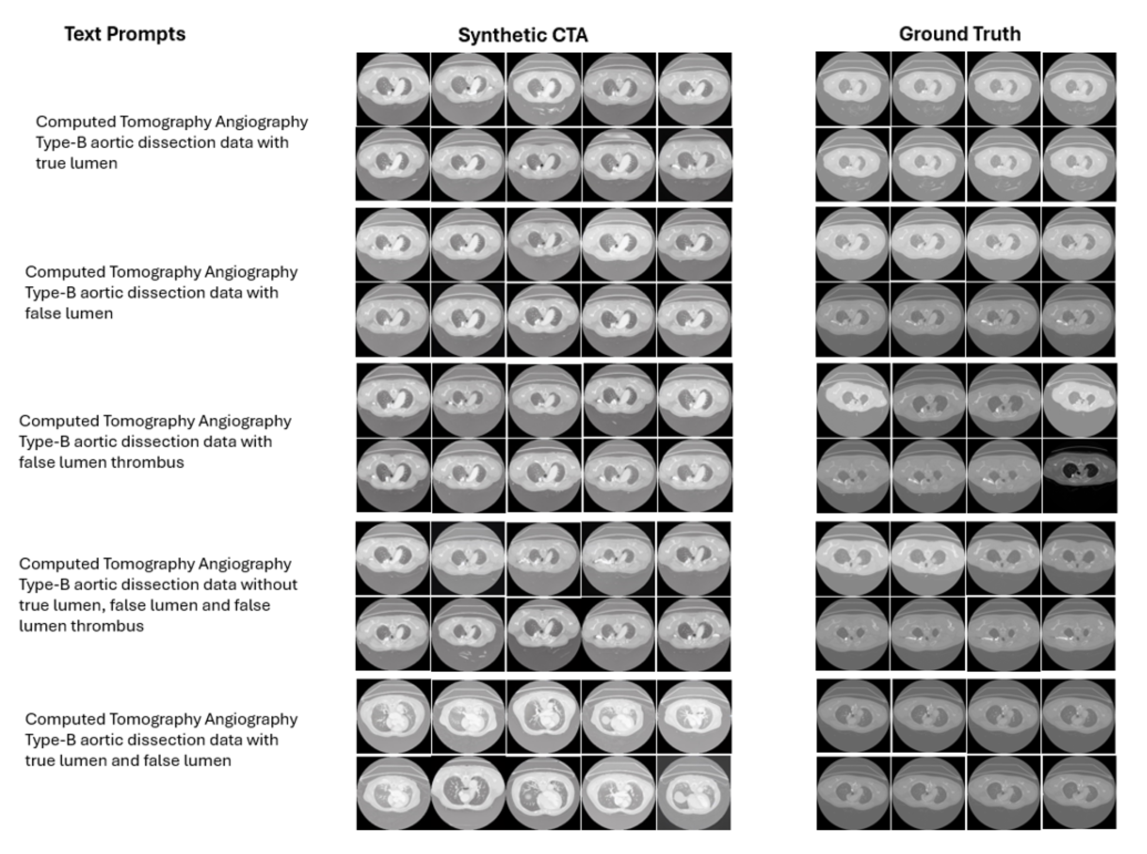
26
Notes:
To validate the synthetic data from quantitative point of you, we chose 2 evaluation metrics,
To measure structural similarity of real and synthetic images, we randomly picked pairs for each class, set and calculated their MS-SSIM. As you can see from the table here that MS-SSIM value among images of each class is lower (I,e images with in the same class are not similaiar to each other), this behavior is also replicated in the synethtic set and for some classes the difference is lower than the other ones.
Also we calculated FID , for FID we utilized Inception-v3 to extract features we computed the distance between the distributions of real images from the test set and synthetic images we got FID score of 77.

Slide 28
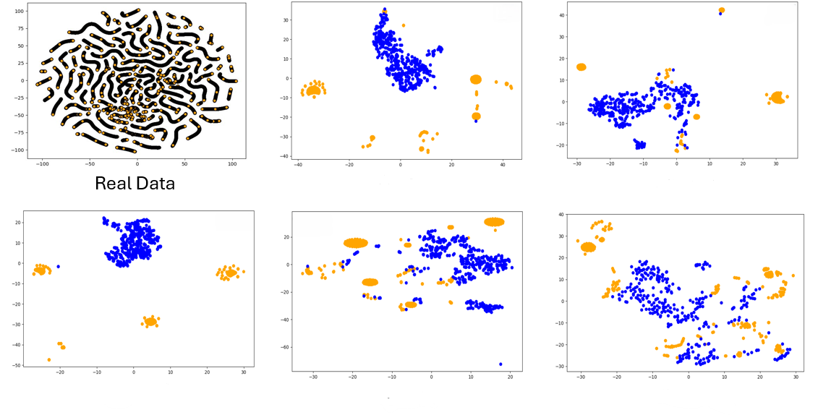
t-SNE Visualization
TL
FL
FLT
No FL TL FLT
TL+FL
27
t-SNE embedding displaying generated samples (shown in blue) from each class along with their nearest real CTAs (shown in orange)

Slide 29
Synthetic Data Validation – 2
Classification
Segmentation
Accuracy
DICE Score
67%
Real Data
75%
Real Data
Real + Synthetic Data
78%
Real + Synthetic Data
76%
28
Notes:
This working is still an ongoing study,

Slide 30
Clinician's Feedback
Twenty synthetic images per class were analyzed by a vascular surgeon to compare their similarities and differences with real TBAD images. According to the clinical partner,
" Synthetic images did demonstrate similarity to the real images. Overall, this study demonstrated promise in being able to segment TL, FL, and FLT using real as well as synthetic data. However, the synthetic dataset was subject to the same limitations as the real images. In particular, the inability to accurately distinguish TL and FL in a single axial slice, out of context, i.e. in a clinical setting. In the existing clinical practice, physicians differentiate TL from FL by scrolling through all the axial images from a single patient and trace the TL from proximal to the entry tear to confirm it is the TL. Especially in dissections that meander down the aorta, confirmation of TL and FL relies on 3D CTA. It is worth noting that in the absence of knowing the clinical age of the dissection (acute vs sub-acute vs chronic) it is challenging to understand how accurate FLT determination is, and this is reflected in the results from both the real and synthetic datasets in which segmentation of FLT is not very precise. This presents a hurdle as the rate of thrombosis is a prognostic indicator for patient outcomes. The prognosis or clinical decision-making regarding the necessity of intervention to ascertain factors such as FLT, malperfusion, and the chronicity of dissection can be further improved by expanding the scope of this work to produce sequential frames with the help of advanced computing systems."
29
Notes:
We presented synthetic and real images to a vascular surgeon for analysis. According to the clinical partner, synthetic images demonstrated similarity to the real images. However, the synthetic dataset was subject to the same limitations as the real images. In clinical practice, physicians differentiate the true lumen (TL) from the false lumen (FL) by scrolling through all the axial images from a single patient and tracing the TL from the proximal to the entry tear to confirm it as the TL. It is important to note that the clinical age of the dissection is crucial for FLT determination.

Slide 31
Limitations and Future Work
This is a first step.
Based on clinician feedback, our focus will be on utilizing clinical data alongside CTA sequential data to enhance the diagnostic process.
Additionally, we will evaluate the performance of generating synthetic data and their corresponding masks for measuring aortic diameters
30
Notes:
Although the results look promisng

Slide 32
References
Yao, Z., Xie, W., Zhang, J., Dong, Y., Qiu, H., Yuan, H., ... & Huang, M. (2021). Imagetbad: A 3d computed tomography angiography image dataset for automatic segmentation of type-b aortic dissection. Frontiers in Physiology, 12, 732711.
Tsai, T. T., Schlicht, M. S., Khanafer, K., Bull, J. L., Valassis, D. T., Williams, D. M., ... & Eagle, K. A. (2008). Tear size and location impacts false lumen pressure in an ex vivo model of chronic type B aortic dissection. Journal of vascular surgery, 47(4), 844-851.
Yuan, X., Mitsis, A., & Nienaber, C. A. (2022). Current understanding of aortic dissection. Life, 12(10), 1606.
A. Karthikesalingam, The diagnosis and management of aortic dissection, Vascular and Endovascular Surgery 44 (2010) 165–169.
M. S. Hansen, G. J. Nogareda, S. J. Hutchison, Frequency of and inappropriate treatment of misdiagnosis of acute aortic dissection, The American journal of cardiology 99 (6) (2007) 852–856.
Cao, L., Shi, R., Ge, Y., Xing, L., Zuo, P., Jia, Y., ... & Guo, W. (2019). Fully automatic segmentation of type B aortic dissection from CTA images enabled by deep learning. European journal of radiology, 121, 108713.
Wobben, L. D., Codari, M., Mistelbauer, G., Pepe, A., Higashigaito, K., Hahn, L. D., ... & Willemink, M. J. (2021, November). Deep learning-based 3D segmentation of true lumen, false lumen, and false lumen thrombosis in type-B aortic dissection. In 2021 43rd Annual International Conference of the IEEE Engineering in Medicine & Biology Society (EMBC) (pp. 3912-3915). IEEE.

Slide 33
Cao, L., Shi, R., Ge, Y., Xing, L., Zuo, P., Jia, Y., ... & Guo, W. (2019). Fully automatic segmentation of type B aortic dissection from CTA images enabled by deep learning. European journal of radiology, 121, 108713.
Wobben, L. D., Codari, M., Mistelbauer, G., Pepe, A., Higashigaito, K., Hahn, L. D., ... & Willemink, M. J. (2021, November). Deep learning-based 3D segmentation of true lumen, false lumen, and false lumen thrombosis in type-B aortic dissection. In 2021 43rd Annual International Conference of the IEEE Engineering in Medicine & Biology Society (EMBC) (pp. 3912-3915). IEEE

Slide 34
Thank you for listening!
I welcome any questions
Notes:
Thats about it and , Thank you. I’d be happy to answer any questions you may have.

